Slide 1
Fidelity Clustering Group
Shuting, Guangze, Shuning, Yujia, Zara

Slide 2
Types of grouping (based on 2021 Q2)
Trend between execution and actual credits
Cluster by log odds of actual and execution credits
Cluster by dynamic efficiency
Cluster using PCA
Notes:
2021 Q2 is stable period from group 1. We have four perspectives of grouping. Firstly, we would like to show trend between execution and actual credits. Then, we would like to cluster by log odds of actual and execution credits. Third one is clustering by dynamic efficiency. The last one is clustering by PCA. However, for now, we don’t know which grouping method is better because we don’t have true label for each warehouse. Although four grouping methods don’t have solid conclusion, we would like to investigate the reasoning behind and which perperspective of data that we should focus on.

Slide 3
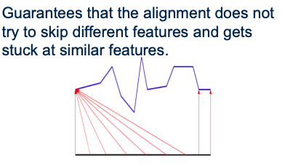
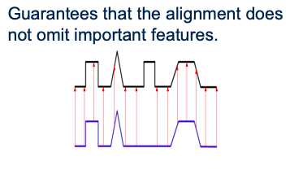
The definition of time series distance
Window size=7
(DTW distance)
Window size=1
(Euclidean distance)
Notes:
Before we talking about specific grouping method, I would like to introduce the definition of time series distance and why we care about it. The first step is that we will divide two series into equal points. In our case, we insert 0 to missing date to make sure the length of each time series is the same. This is from Group 1’s result. Thanks! The second step is that we calculate the euclidean distance between the first point in the first series and every point in strict window in the second series. We store the minimum distance for each point in the first time series. The third step is to repeat for each point in the first series and sum the minimum distances together. We use different window size to keep track different comparison target. When we compare different warehouse, we should have window size larger than 1, to have more tolerance of shape. When we compare single warehouse’s actual and execution, we should restrict the window size to 1, which can make sure “moment to moment” change.

Slide 4
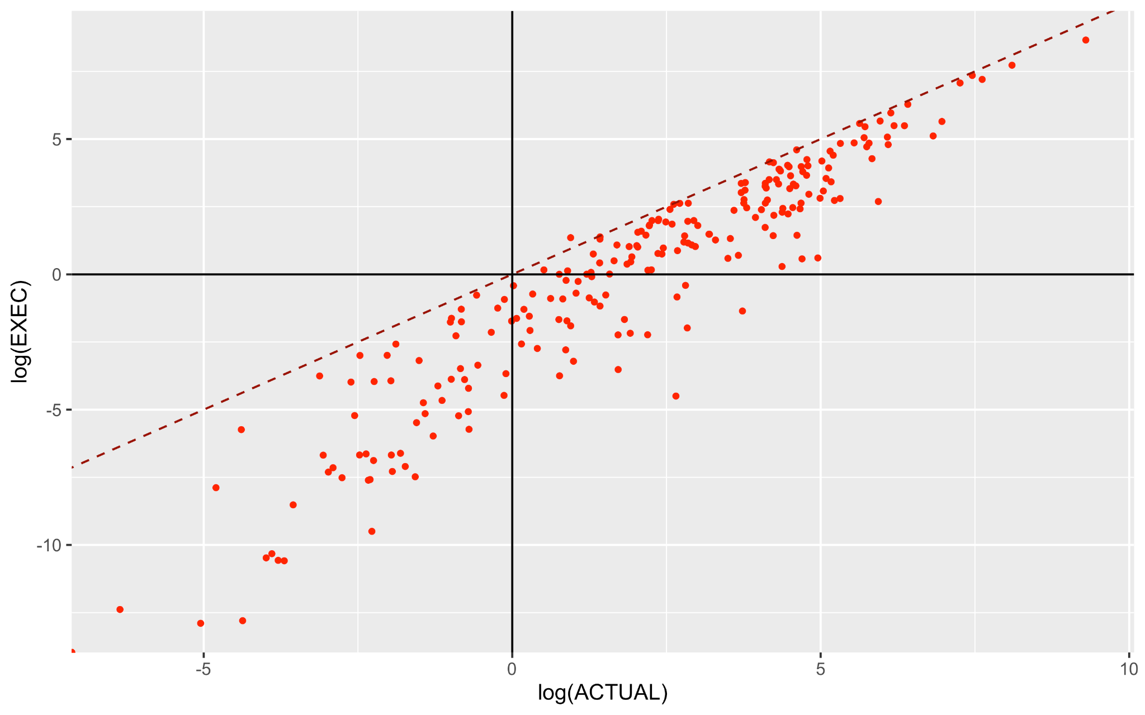
Clustering based on trend between execution and actual credits

Slide 5
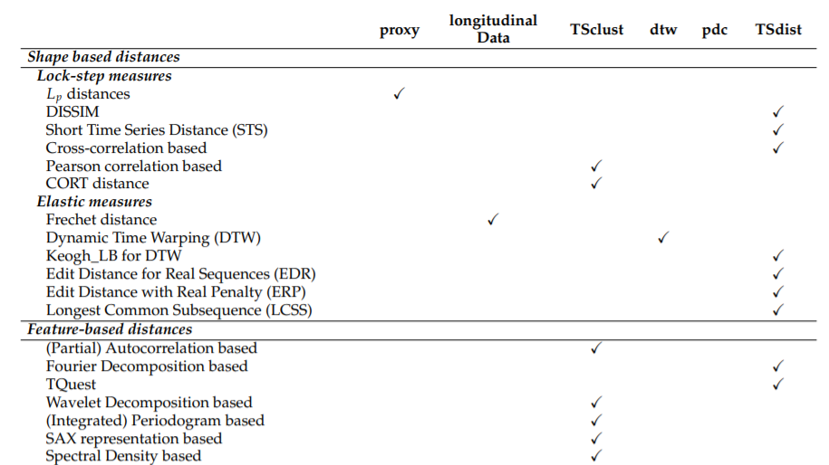
Data:
efficiency
= log(actual+1/execution+1)
Distance:
DTW (window size =7) / TQuest
Cluster:
k-means / hierarchical

Slide 6
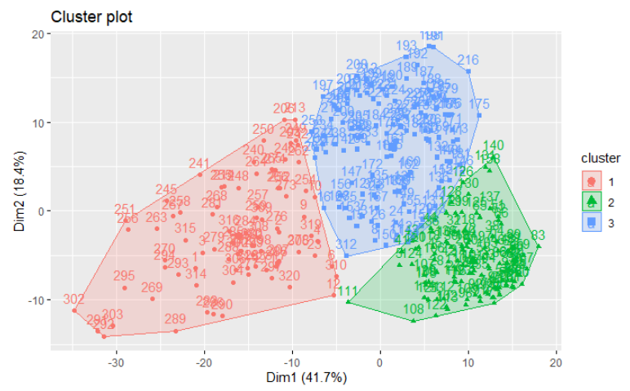
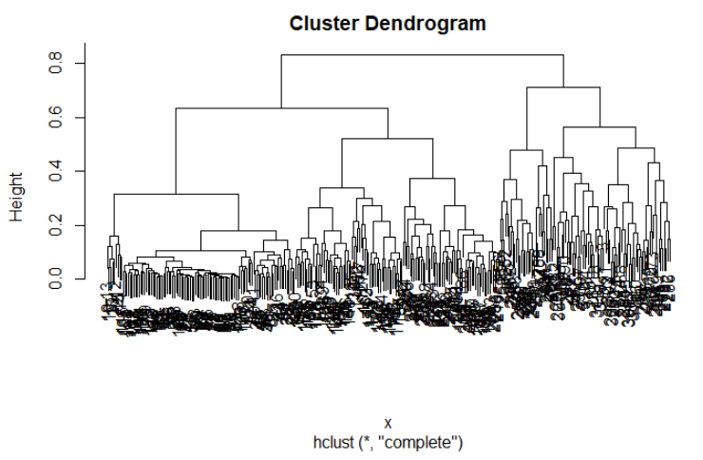

Slide 7
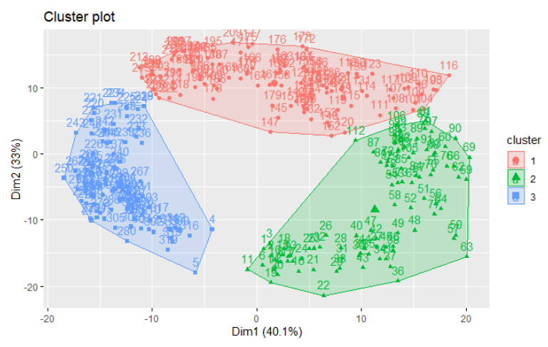
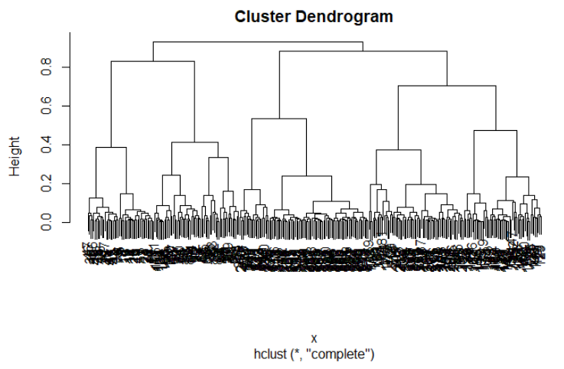

Slide 8
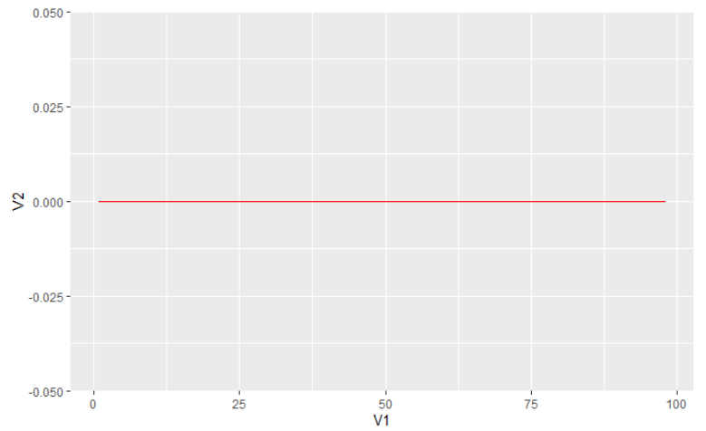
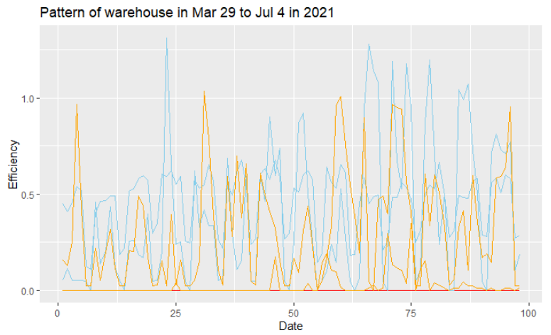
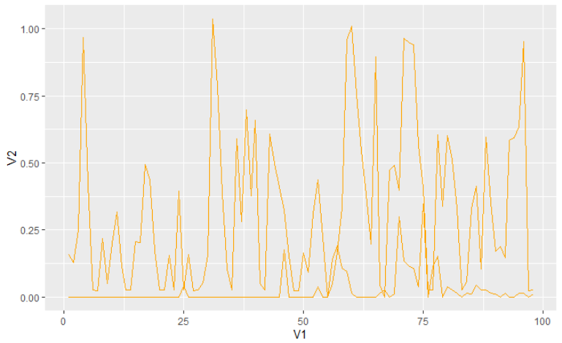
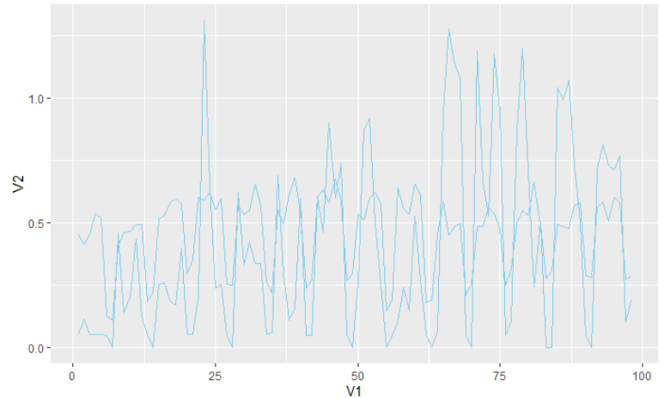
orange: 107,111 red: 315,269 blue: 147,216

Slide 9
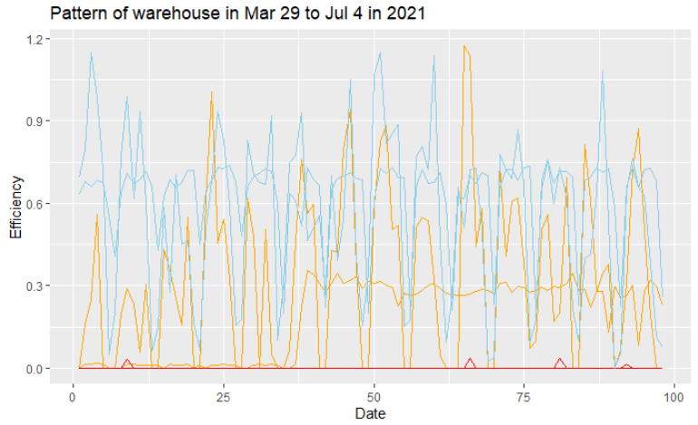
orange: 240,305 red: 179,120 blue: 26,49

Slide 10
Dynamic Efficiency
Aim: capture dynamic efficiency pattern in a chopped time period
Method: measure shape-based distance of execution and actual credit series in a specific period.
Clustering warehouses based on dynamic efficiency: divide 320 warehouses into 6 groups based on the distance we measured and their actual and execution credit.
Go further: randomly pick warehouse from group with big actual credit and compare their execution and actual credits trends.
Notes:
Capture a character of different warehouses.

Slide 11
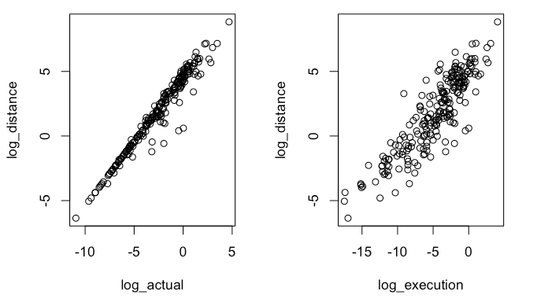
Explore Dynamic Efficiency
2021-03-29 ~ 2021-07-04
Dynamic Efficiency shows higher correlation with Actual Credit.

Slide 12
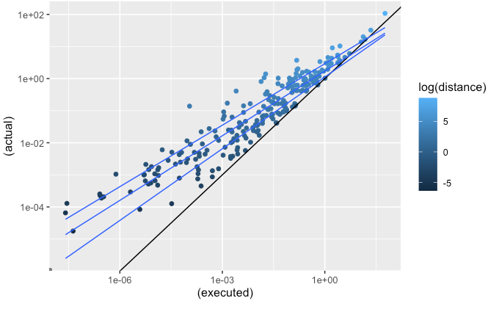
Compare Dynamic Efficiency with Efficient Ratio
2021-03-29 ~ 2021-07-04
When actual credit increases, warehouses show high ratio while high distance
Notes:
Ratio is high means good average efficiency, but high distance shows efficiency not stable in this period

Slide 13
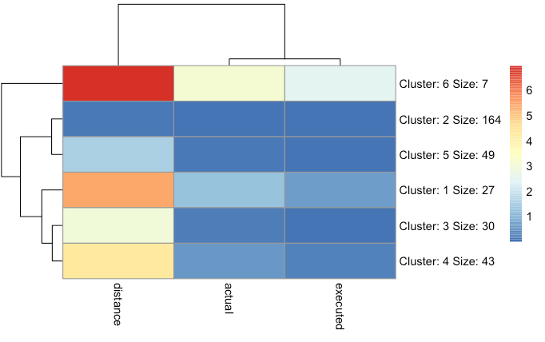
Clustering by Dynamic Efficiency & Actual & Execution
Split warehouses into 6 group
Look into cluster with unstable efficiency (cluster 6, cluster 1, cluster 4)
Notes:
Big distance & big actual credit
hierarchical clustering

Slide 14
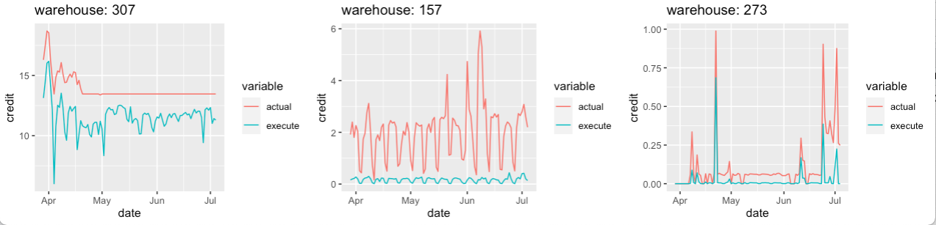
Explore Cluster with High Actual Credit
Randomly pick one warehouse from cluster 6, cluster 1 and cluster 4, which ID is 307, 157,273.
Time Period: from 2021-03-29 to 2021-07-04.
From the plot, we can see warehouse in the first plot shows clearly unstable efficiency. We can focus on these warehouses.
Large distance &
big actual credit
Relatively large distance &
big actual credit
Less large distance &
big actual credit
Notes:
Next step focus on these warehouses

Slide 15
Clustering using PCA
Target series: 1. Actual credits 2. Efficiency(Execution/Actual credits)
Time Period: from 2021-03-19 to 2021-07-04. 135 days
Both actual credits and efficiency of different days are correlated
Advantage
Capture the essence of the data in a few principal components, which convey the most variation in the dataset. Instead of simply comparing sums or averages, which would ignore the variation of the series over time
Disadvantage
Hard to interpret: What is PC1 or PC2?

Slide 16
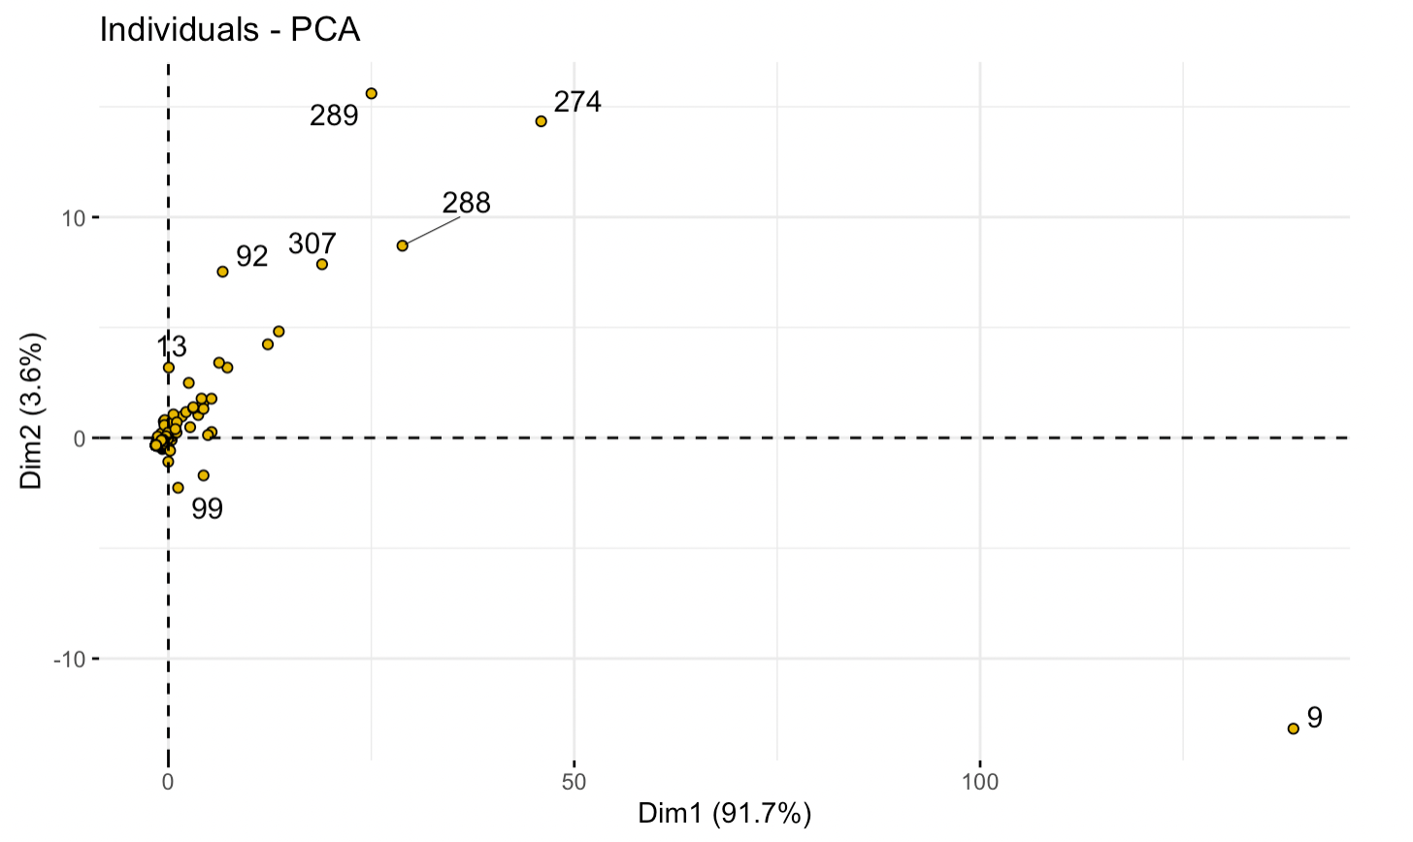
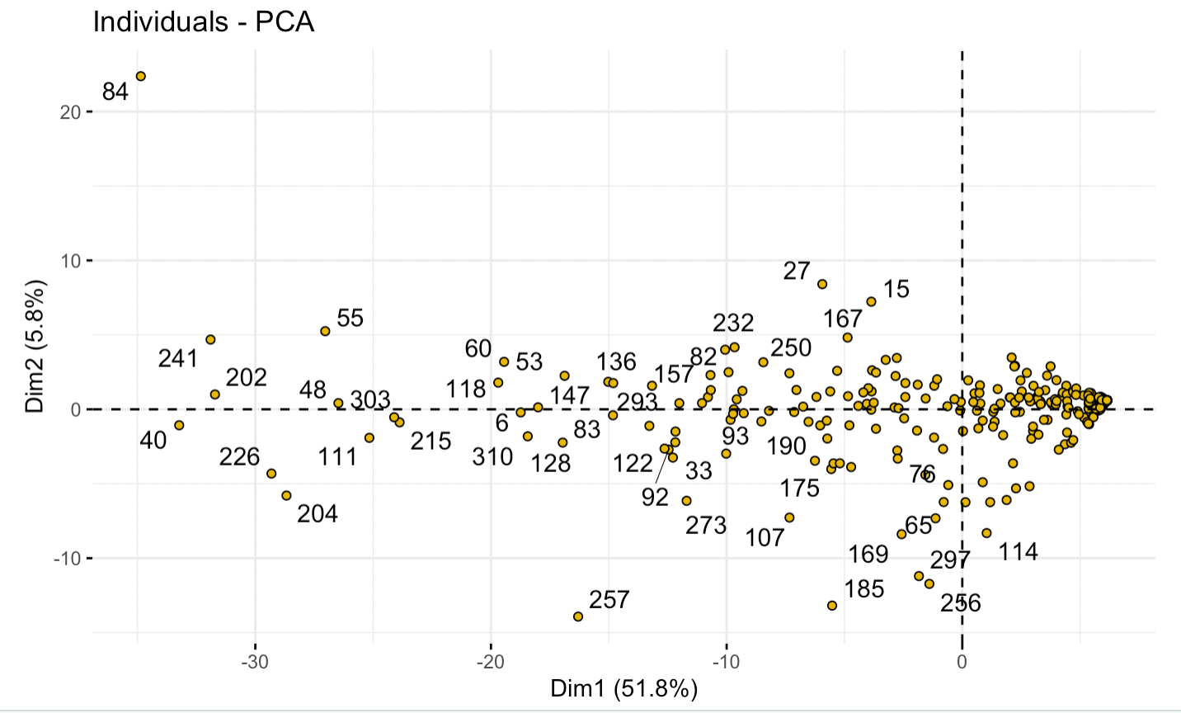
PCA score plot
Actual credits
Efficiency-log(execution/actual)
X-axis(PC1): Equally weighted sum of the 135 days’ actual credits
Y-axis(PC2): Contrast between first 80 days’ actual credits and last 50 days’ actual credits
X-axis(PC1): Equally weighted sum of the 135 days’ efficiency
Y-axis(PC2): Contrast between first 85 days’ efficiency and last 40 days’ efficiency

Slide 17
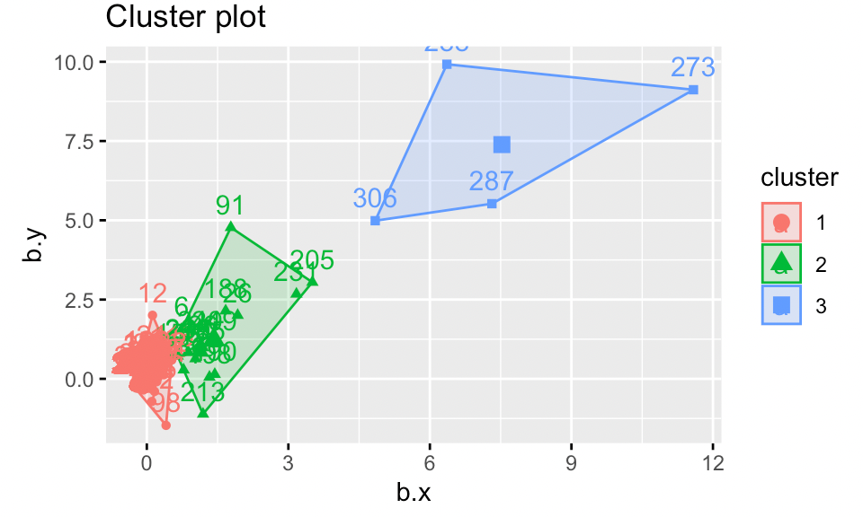
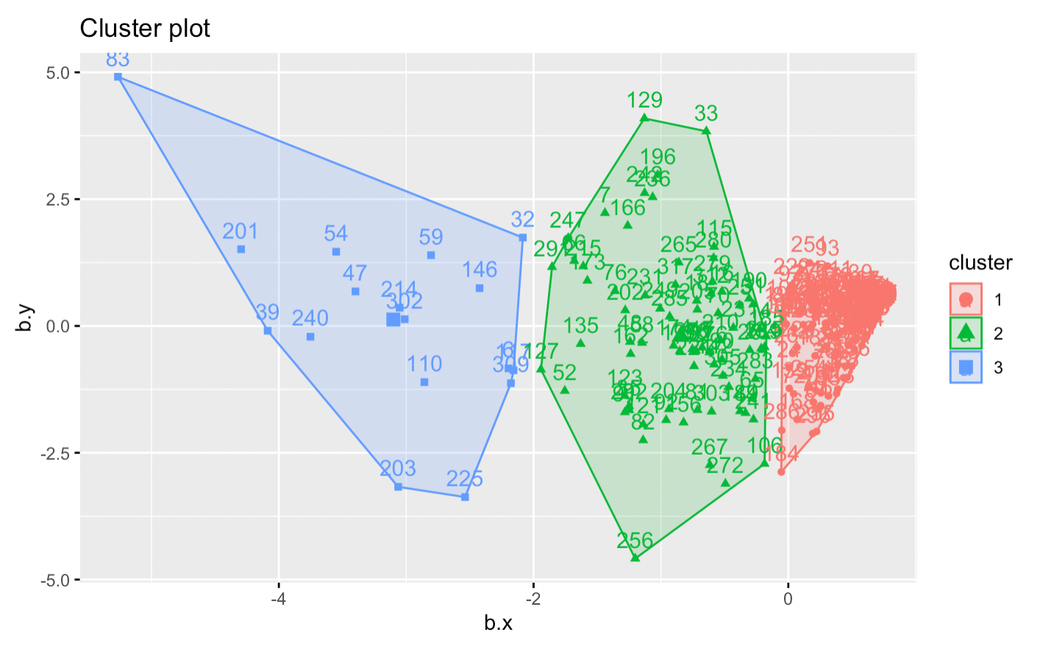
Three Clusters
Actual credits
Efficiency-log(execution/actual)

Slide 18
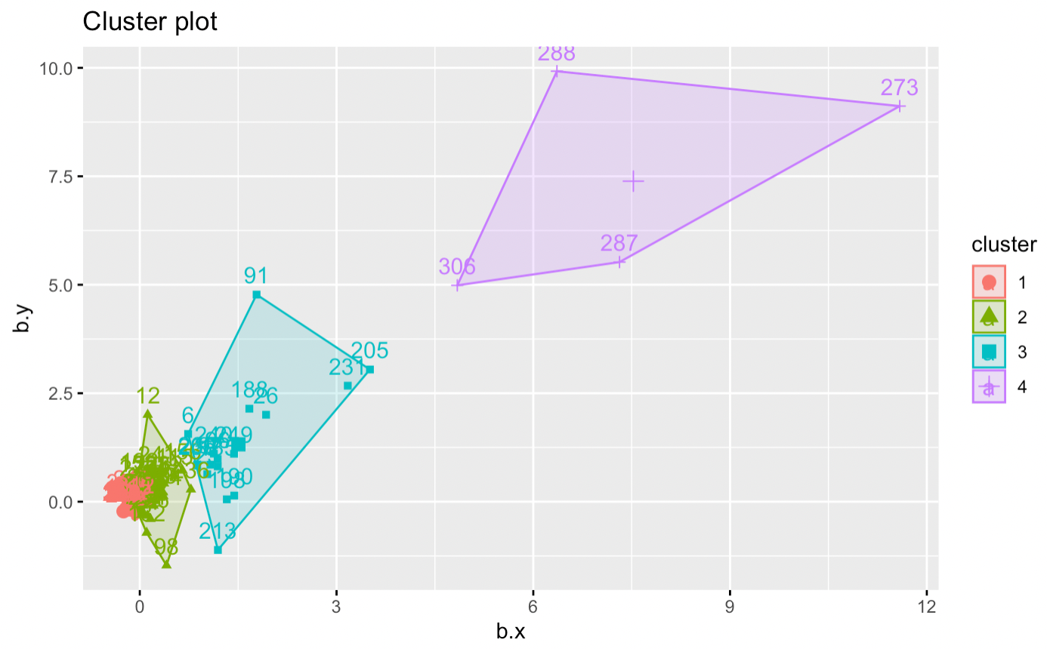
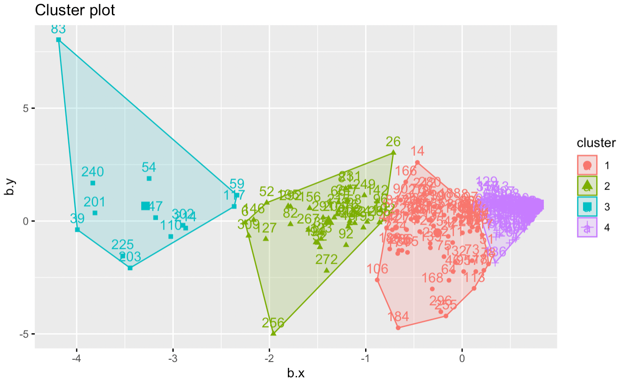
Four Clusters
Actual credits
Efficiency-log(execution/actual)
Notes:
Question:
1. Which grouping method should focus on more for the further analysis? In other words, how could we evaluate our clustering method? In traditional method, we calculate the precision of labels.
2.
Based on the stable warehouse period,
One group for change point, one group only for other
Prediction for next year, how much will be saved
Presentation should be together
change point, clustering,Forecast

